Slide 1
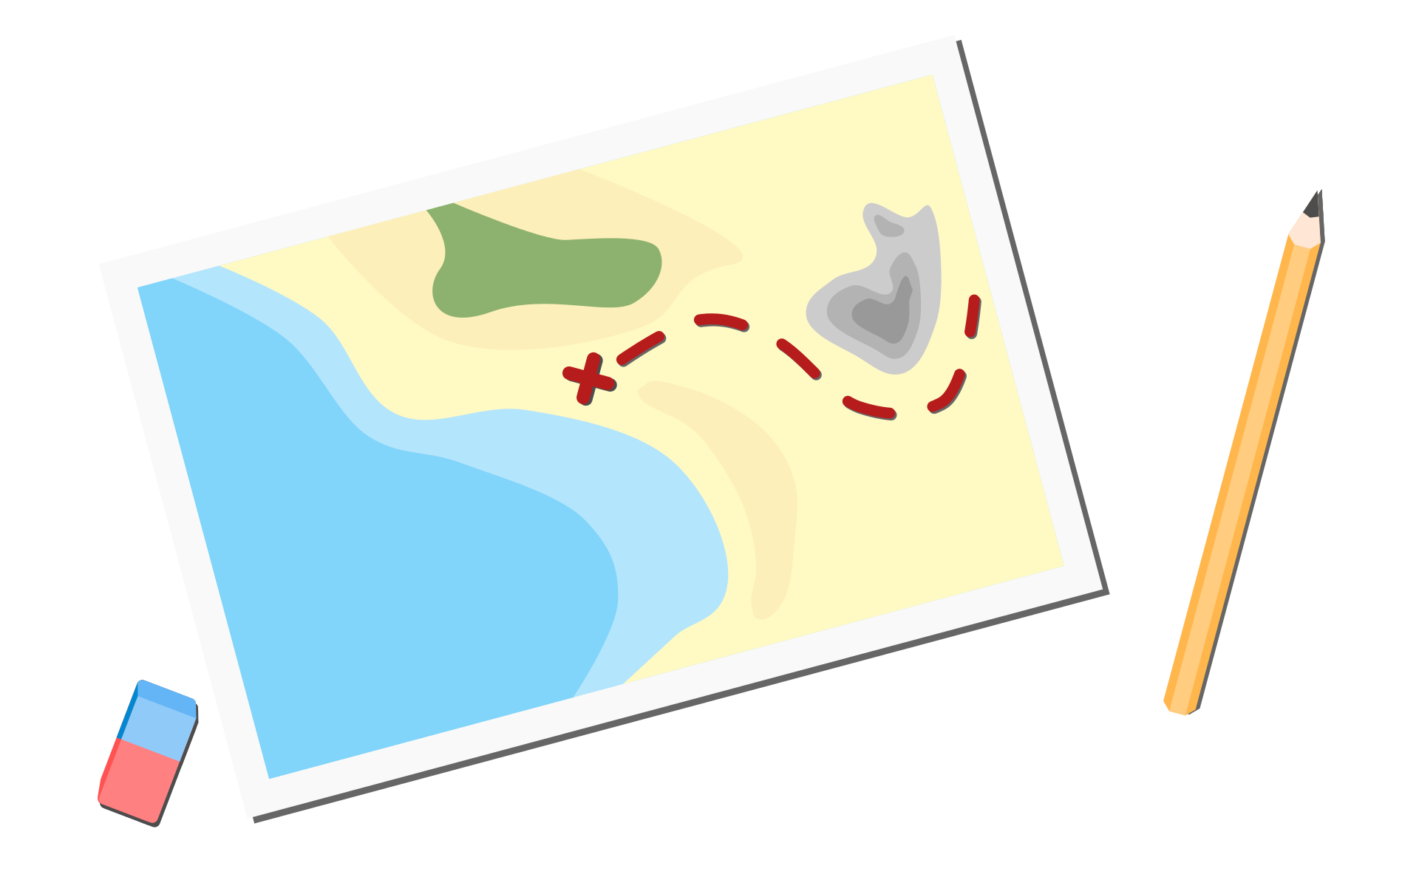

Home Services routing optimisation
Group 8
Gyu Hwan Park Jinlu Luo Xueming Li
Weitian Zhang Rui Li Jean Ma

Slide 2
Part 1
Mixed Integer Programming

Slide 3
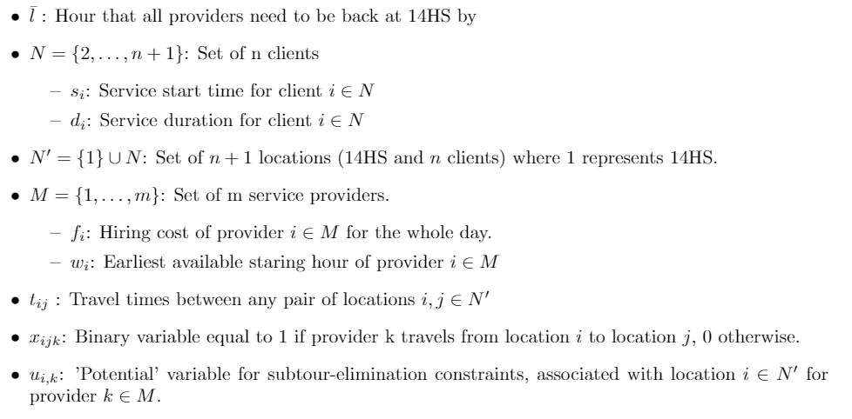
MIP model
Part 1: Formulation
Data:
Variables:
Notes:
Here’s quick run-through of the data and variables we used in the MIP model.
We made slight changes in the notation for clients, where big N represents n clients, indexed from 2 to n+1.
N prime represents the set of n+1 locations, including 14HS which is represented by index 1.
For the variables, we have x_ijk equal to 1 if provider k travels from location i to location j, 0 otherwise.
We have a potential variable associated with each location for each provider to be used in subtour-elimination constraints.

Slide 4
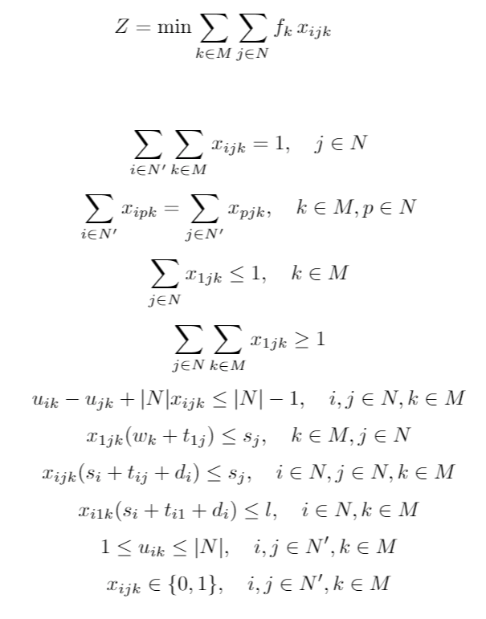
MIP model
Part 1: Formulation
Objective function:
Routing constraints
Time constraints
Notes:
This is our final MIP model.
This objective function minimizes the sum of one-off payments to service providers who serve at least one client.
The first 5 constraints correspond to the routing constraints, very similar to assignment 2.
The next 3 constraints correspond to the time constraints, that ensure the providers arrive no later than the service start times, and return back to 14HS by hour l.

Slide 5
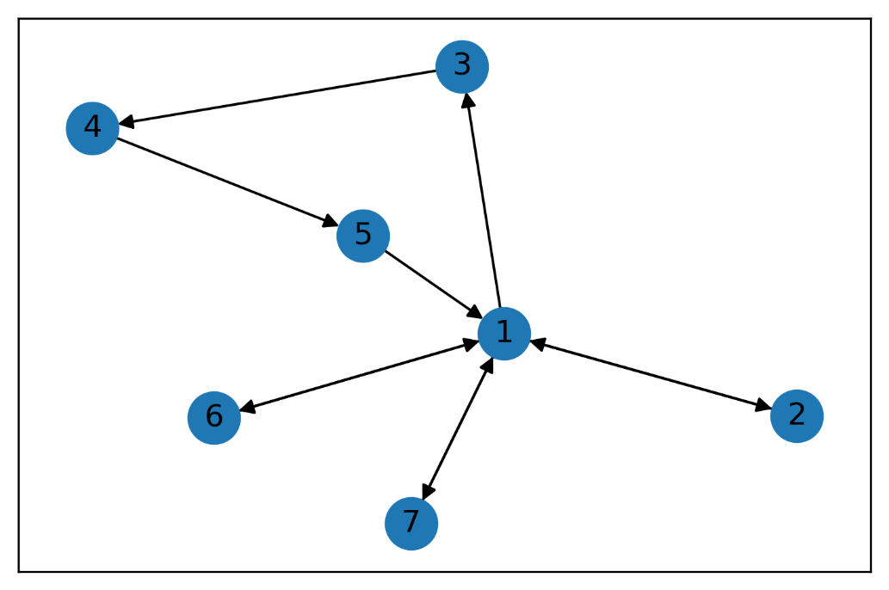
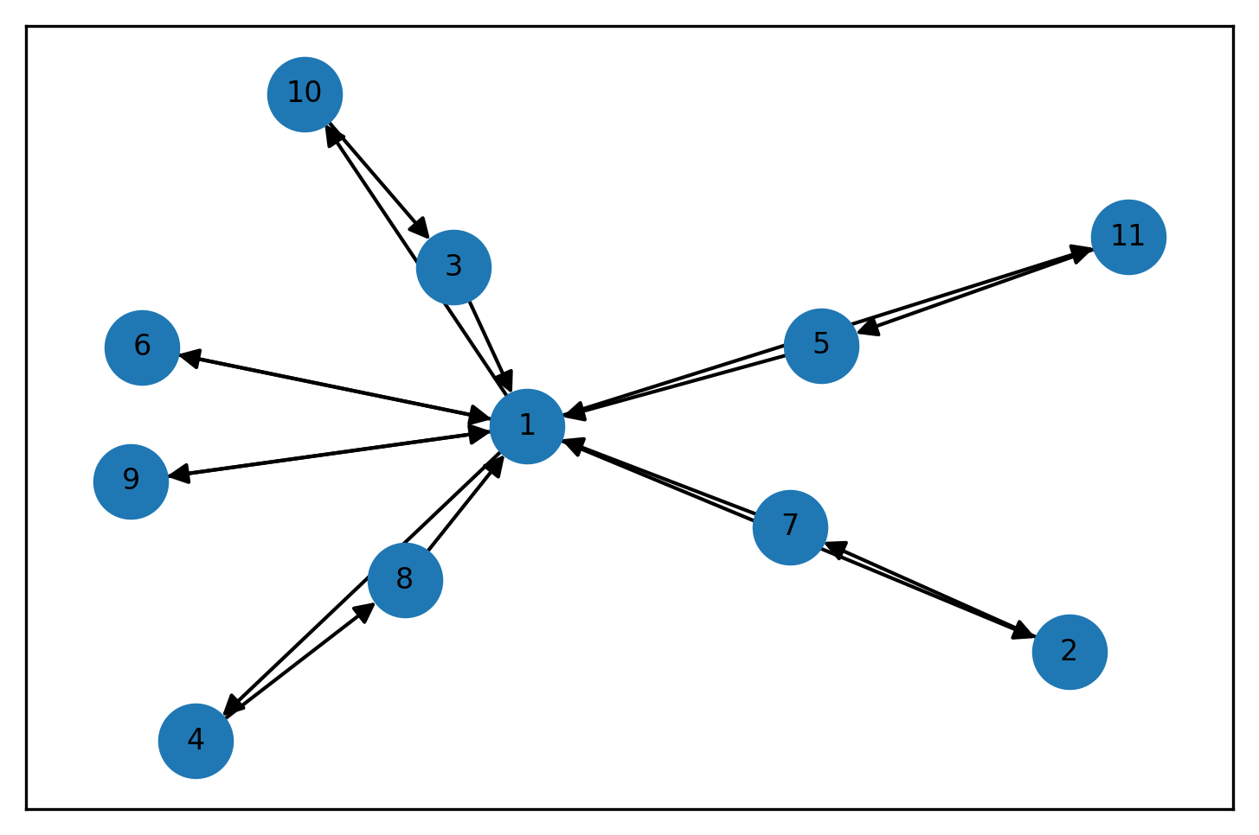
Sample route assignments
Part 1: Visualisation
Route assignment for 6 clients
Cost = $45
Route assignment for 10 clients
Cost = $81
Notes:
These are visualisation of sample route assignments provided by our MIP model.
On the left, is an optimal route assignment of providers to 6 clients, with minimal cost 45$. The data used is the Example data 1 from tutorial 7.
On the right, is an optimal route assignment for 10 clients. Here, the data is randomly generated such that a feasible solution exists. For more detail in the data generation process, please refer to our report.
From now on, all visualisations and results use the datasets that we randomly generated.

Slide 6
Part 2
Extensions

Slide 7
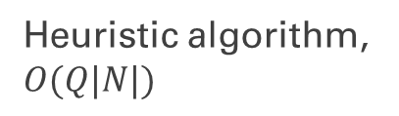
Matheheuristic
Part 2.1: Matheheuristic
Motivation: MIP model is optimal, but slow for larger problems.
Combine a faster heuristic algorithm with MIP.
Matheheuristic method:
Sort providers by hiring cost, then by available hour;
Sort clients by service starting time;
Iteratively assign clients to cheaper, early-starting providers.
Use as the initial solution for the MIP model.
Heuristic algorithm, $O(Q|N|)$
Notes:
As our first extension for part 2, we developed a matheheuristic that enables MIP model to scale to larger problems.
We combined a faster heuristic algorithm with the MIP from part 1.
A high-level overview of our matheheuristic is as follows:
The idea is to consider cheaper, early-starting providers first when assigning any client, by pre-sorting the set of providers and clients in an appropriate way.
This is an iterative algorithm runtime complexity of O(q*N). Q represents the number of providers who is assigned at least one client.
We then use the routes of providers obtained from this heuristic as the initial solution for the MIP model.
This will eliminate the time required for MIP to find its initial upper bound, as the heuristic provides a reasonably good starting point.

Slide 8
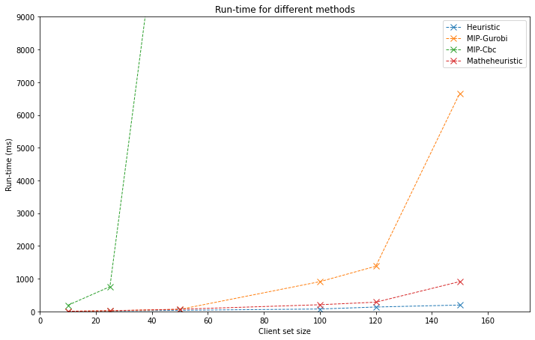
Part 2.1: Comparison
Matheheuristic: fast and optimal;
Heuristic: fastest, but objective values are 0-17% higher;
MIP: terribly slow at large scale.
For client set of size 500:
Heuristic: 1.300 seconds;
Matheheuristic: 25 hours (exp.);
MIP-Gurobi: 203 days (exp.).
Clients: randomly generated;
Providers: fixed with size 200;
Notes:
Here is a plot that shows the run-time for different client sizes, for 4 methods heuristic, matheheuristic, mipgurobi and mipcbc.
We tested these methods on client sets of size 10, 25, …, until 150.
We see that the heuristic is the fastest, but actually its gives 0-17% higher total hiring cost.
MIP models are always optimal, but terribly slow at large scale.
The matheheuristic combines gets the good of both, it is always optimal, but very fast as well compared to plain MIP.
We also considered an extreme case, where we had 500 clients.
The heuristic was able to solve it in 1.3 seconds, although the cost may not be optimal.
Using the plots, we project that the matheheuristic will take 25 hours, and MIP-Gurobi will take 203 days.
So, if you had a client size of 500, it would make sense to use the heuristic. However, if you must have the optimal cost, you could use matheheuristic which will take a day to run.
This is a vast improvement from the 203 days with original MIP.

Slide 9
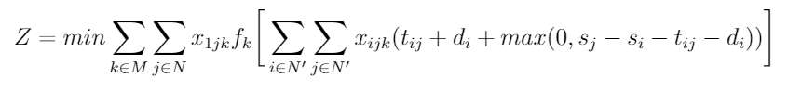
1. Hourly hiring cost of providers
Part 2.2: Changing the objective
Objective: minimize the total hiring cost where providers are paid by the # worked hours
Realistic: prefer routes with less waiting time
# hours travelled & served
# hours waited
# worked hours
Notes:
Here’s our second extension, completely separate from the matheheuristic.
Here, we changed the objective function from part 1, so that now we are minimizing the total hourly hiring cost.
Now, f_k represents the hourly hiring cost for provider k.
The # hours worked consists of # hours travelled, served, and also the waiting hours.
Note that max function is non-linear, however, gurobi optimizer is able to solve this problem anyways.
This change means we now have a more realistic objective function, as it first makes sense to pay workers by the number of hours worked, and also this leads us to prefer routes with less time wasted on waiting.

Slide 10
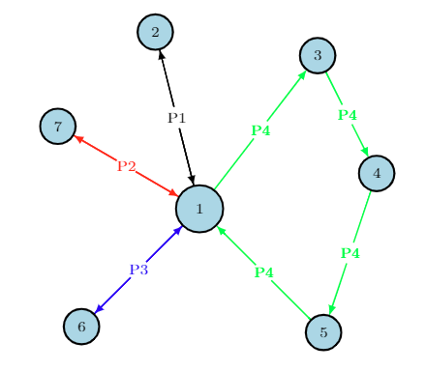
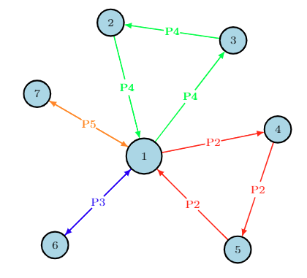
Improved route assignment
Part 2.2: Visualisation
Routes with part 1 objective
Routes with new objective
Provider 1 wastes 3 hours by waiting
Cost = $290
Provider 1 is removed
Cost = $260
Notes:
10 seconds

Slide 11
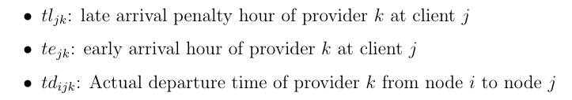

2. Penalty for late arrivals
Part 2.3: Allowing late arrivals
Motivation: MIP model assumes providers can only arrive at each clients before or on start time.
Allow providers to arrive after service start times with fixed penalty fees.
Modification:
Variables:
Notes:
For models mentioned above, we assume that providers cannot arrive at each clients after the start time.
To make our model more flexible, we allow late arrivals with some penalty.
Based on hourly paid model, we add a fixed hourly penalty fee to the data, and add late hours, early hours and actual departure time to the variables.

Slide 12
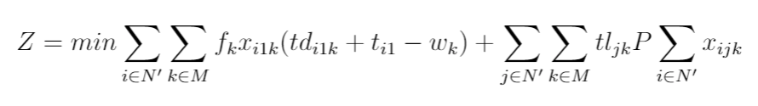
2. Penalizing late arrivals
Part 2.3: Objective function modification
Objective: minimize the total hiring cost including service cost and penalty cost where providers are paid by the # worked hours
# service hours
# Late hours
# Service cost
# Penalty cost
Notes:
The objective function is to minimize the sum of service cost and penalty cost.

Slide 13
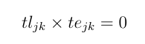
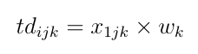
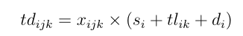
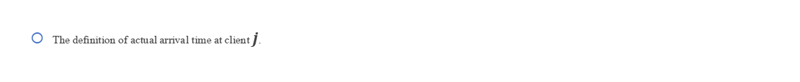
Part 2.3: Constraints setting
Constraints:
Only one condition happen:
The actual departure time from 14HS.
The departure time from clients.
The definition of actual arrival time at client $j$.
Notes:
I will introduce some interesting constraints here.
There are 2 conditions in this model. The first one is one provider arrives on or before the start time and another is the provider arrives after the start time. Only one of them can happen.
The actual departure time of each provider from the depot is its earliest available time.
3. The departure time of provider $k$ from client $i$ to $j$ is the sum of client available time, late hours and service duration at client $i$.
4. Shows two ways to represent the actual arrival time at client j.

Slide 14
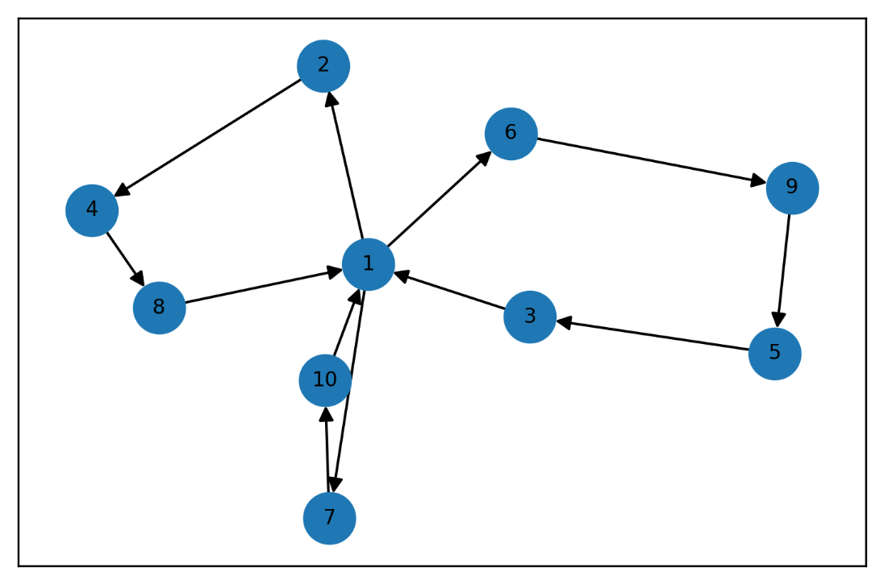
Sample route assignments
Part 2.3: Visualisation
Penalizing late arrivals model
Infeasible solution
in hourly paid model
Cost = $368
Notes:
When we test the same example in hourly paid model, it gives us infeasible solution. However, penalizing late arrivals model gives us a solution, which allows some late arrivals. for example provider 6 arrives at client 9 with 5 hours after the agreed time.

Slide 15
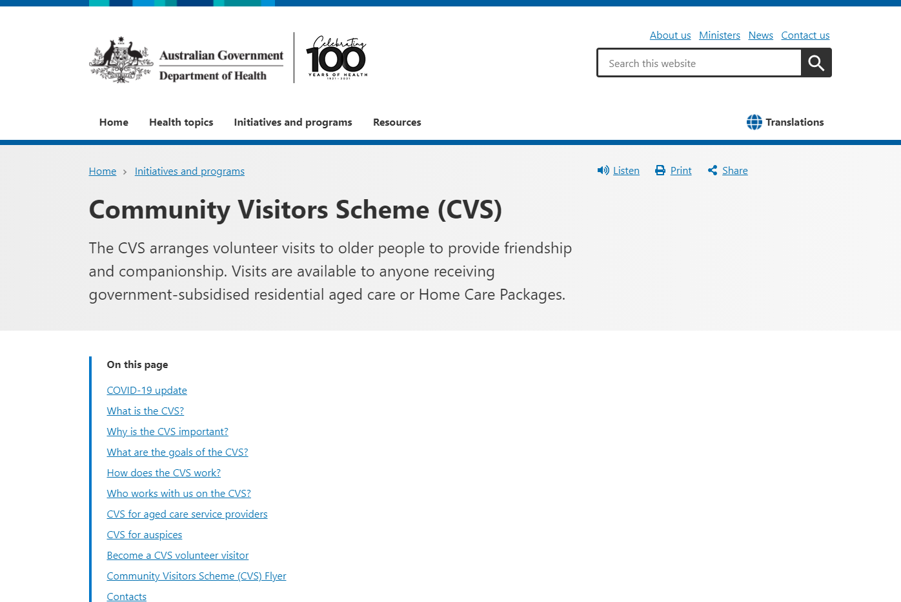
3. Multiple-Services for clients
Part 2.4: Multiple-Services
Motivation:
https://www.health.gov.au/initiatives-and-programs/community-visitors-scheme-cvs#cvs-for-aged-care-service-providers
Notes:
Our extension 3 is motivated by a real program called Community Visitors Scheme from the Department of Health.
This CVS aims to improve the life quality of older people in aged care facilities by arranging visits to provide language support.
This is a screenshot of the official website, and here is its link (pointing to the picture and link).

Slide 16
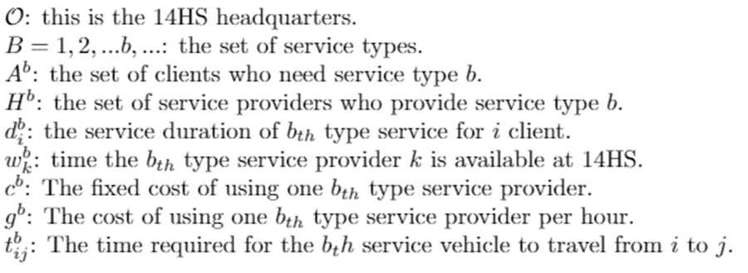

Part 2.4: Multiple-Services
Old people from culturally and linguistically diverse backgrounds, so our service providers need different linguistically diverse backgrounds as well.
We built this extension based on a variant of VRP, Multiple-Services VRP.
Modification :
One provider offers one type of service (language);
One client (aged care facility) needs multiple services (languages).
Additional Data ：

Slide 17
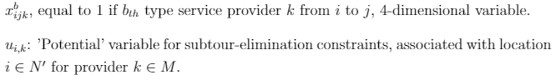
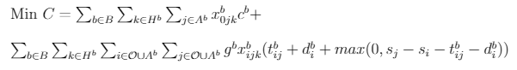
3. Multiple-Services for clients
Part 2.4: New objective
Variables:
Objective:
Fixed cost
Hourly cost

Slide 18
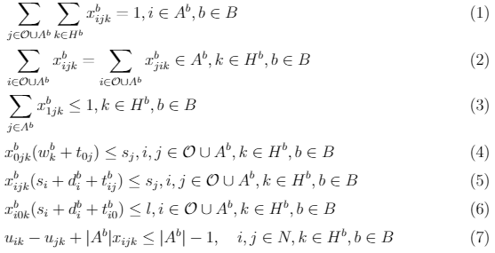
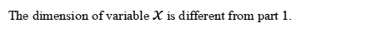
3. Multiple-Services for clients
Part 2.4: Similar constraints
Constraints:
The dimension of variable $x$ is different from part 1.
Different clients may need different services, so the main settings are like part 1, except additional loops on service types.

Slide 19
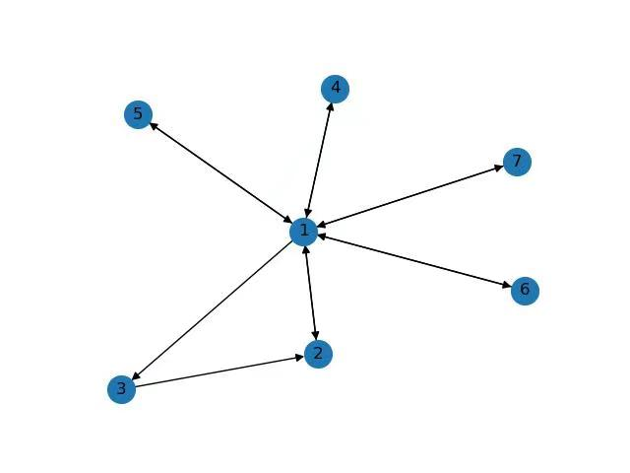
3. Multiple-Services for clients
Part 2.4: Visualisation
Sample route assignments
Change pic
Notes:
Explain clearly whats happening between 1, 2, 3.

Slide 20
Improvements

Slide 21
Improvements
Run-time comparison: Compare problems of larger size, with finer detail;
Explore metaheuristics like Taboo Search and Column Generation to compare with our matheheuristic;
Penalty term need not be fixed. Explore different settings.
A language supporter could speak multiple languages thus provide different types of services.
Multiple-Services for both clients and providers
Notes:
It is also an extension worth searching;

Slide 22
Conclusion

Slide 23
Conclusion
Formulated the problem as VRP with time and routing constraints;
Developed multiple extensions to:
Boost the run-time;
Make more realistic sense;
Extend to more complex situations.
Range of potential improvements identified given more time.
Buy our home services routing optimisation service!

Slide 24
Thank you

